Slide 1

Requirement for Customer Whitelist Menu
Rajesh paudel
2021.11.23

Slide 2
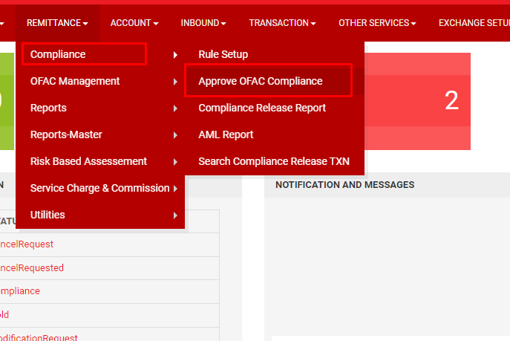
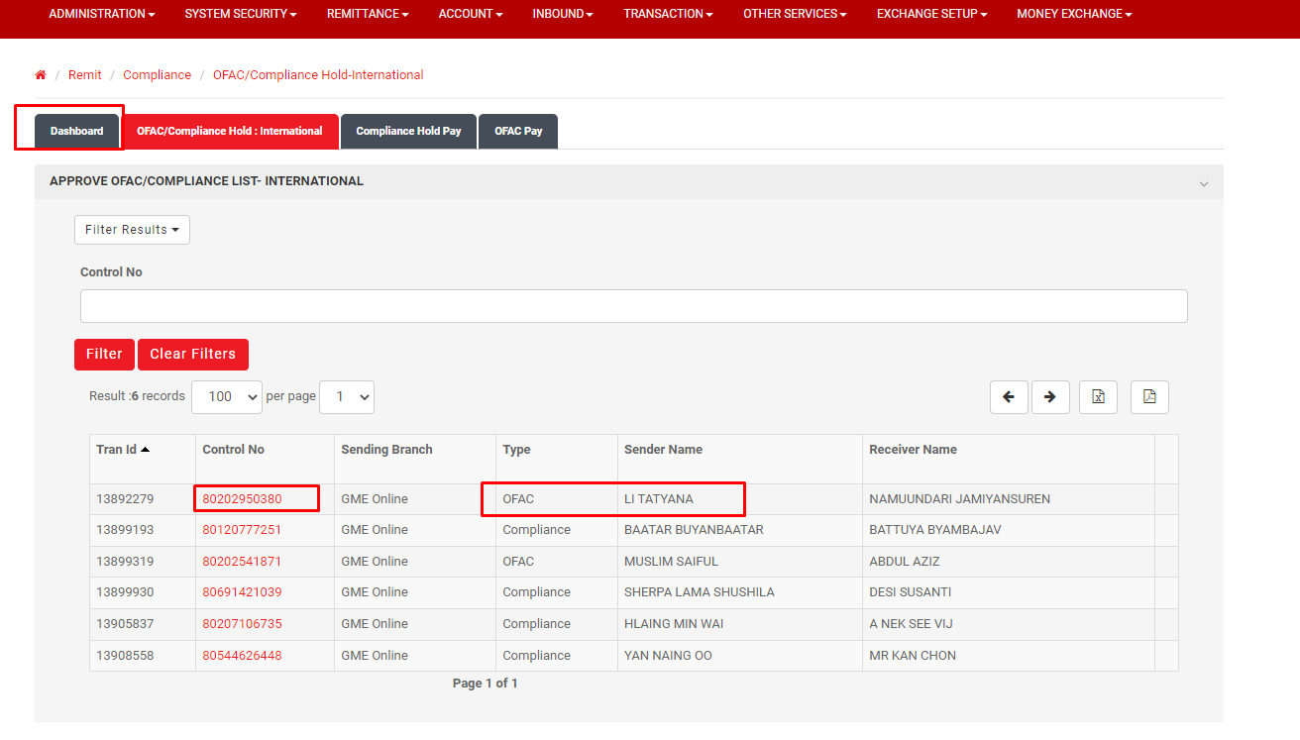
1.Admin System menu
Admin Menu> Remittance>> Compliance>>Approve OFAC compliance
Click Control No, go to compliance or OFAC hold transaction Type.
Notes:
1. 송금을 하는 중에 OFAC 체크에 걸리면 송금 데이터가 홀딩된다.
2. 홀딩된 데이터를 송금하기 위해서는 홀딩된 데이터를 클릭한다.

Slide 3
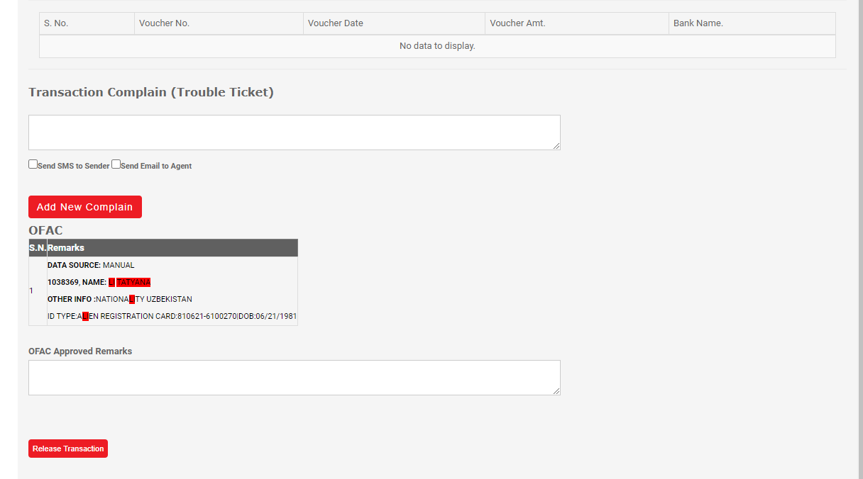
Click on Whitelist customer menu both for OFAC Hold and Compliance Hold Transaction.
Release Transaction
Whitelist Customer
Notes:
1. 홀딩된 데이터를 다시 송금하기 위해서는 Release Transaction 버튼을 클릭한다.
2. 만약, 다음부터 OFAC 에 걸리지 않기 위해서 WhiteList 데이터를 제작하기 위해서는 Whitelist Customer 버튼을 클릭한다.

Slide 4
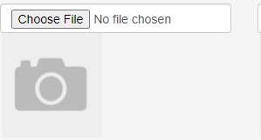
case
Info required to whitelist customer
Whitelist Customer
If select sender show this page
Sender/Beneficiary
Sender
.
Customer Id/Receiver Id
123456
Full Name
Relationship
Source of Fund
Allow admin to select the list from dropdown menu for Family details, source of fund, Nationality, Customer Occupation field and fill all the necessary information which was included.
Nationality
Date of Birth
Customer occupation
Salary Statement
Id Type
Id Number
Customer Id card
Contact No
Expiration Date
Whitelist Customer
Notes:
1. WhiteList 테이블을 제작한다.
Family Details: Relationship dropdown menu
Mandatory Field for sender
- Sender/Receiver
- Source of Fund
- Nationality
- Date of Birth
- Id Type
- Id Number
- Contact No
- - Expiration Date

Slide 5
case
Info required to whitelist customer
Whitelist Customer
Sender/Beneficiary
Beneficiary
If select Beneficiary show this page
Customer Id/Receiver Id
123456
.
Full Name
Relationship
Nationality
Date of Birth
Place of Birth
Current address
Occupation
Id Type
Id Number
Customer Id card
Contact No
Bank Account Number
Expiration Date
Whitelist Customer
Notes:
Family Details: Relationship dropdown menu
Mandatory Field for sender
- Sender/Receiver
- Source of Fund
- Nationality
- Date of Birth
- Id Type
- Id Number
- Contact No
- - Expiration Date

Slide 6
Menu Required
Note:
Make all field mandatory to fill up
Whitelist customer
If sender
Date of birth and mobile no should be matched,
If beneficiary
Nationality and mobile no should be matched
If bank deposit beneficiary bank account number should be match.
Menu required in Admin system
->Whitelisted customer list-> show customer list which was whitelisted including details, customer name, wallet number, country name and contact number.
->Compliance released transaction list- show compliance auto released transaction list with remarks reason for whitelisted customer for compliance reporting purpose.

Slide 7

THANK YOU
2

